Slide 1
Working in small and large teams
Mikael Kalms, DICE

Slide 2



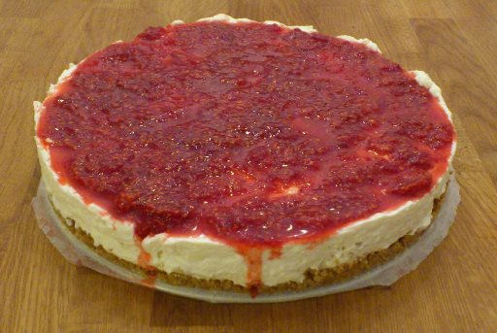
Me.

Slide 3
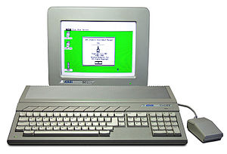
My formative years

Slide 4
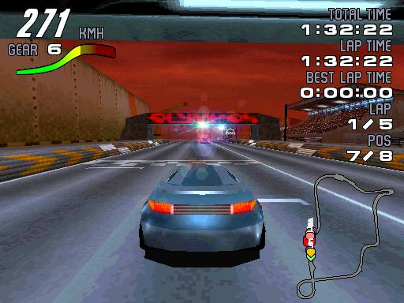

I've worked on games.

Slide 5
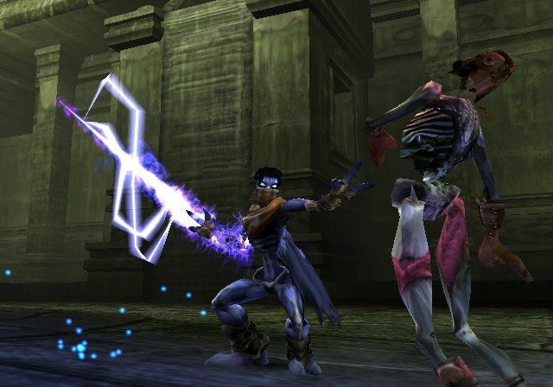

I've worked on games.

Slide 6

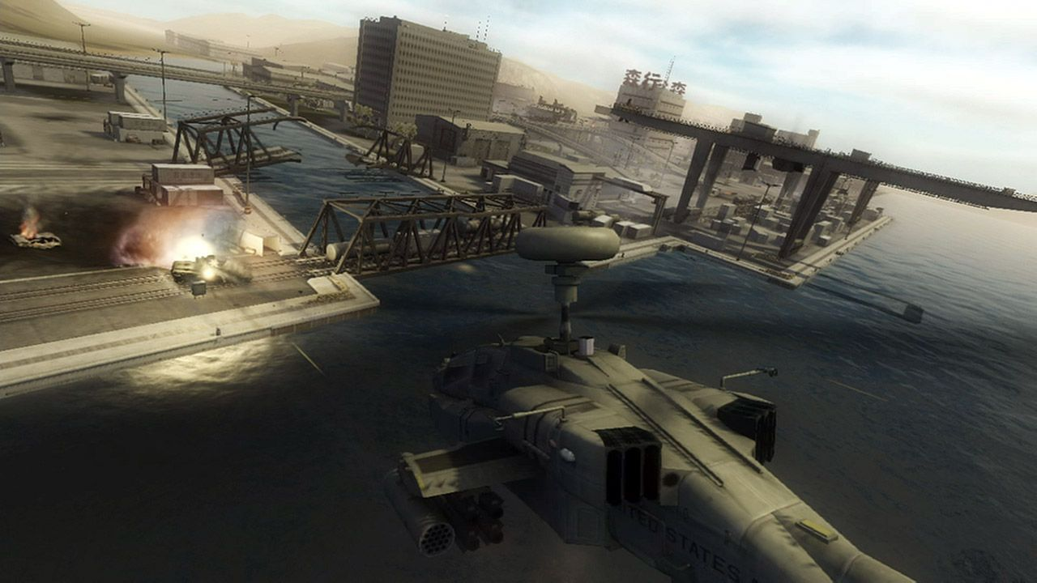
I've worked on games.

Slide 7

I've worked on games.

Slide 8
But, on to the real topic.

Slide 9
Working in small teams
Team size: one person… you.

Slide 10
Is this you?
“I’m gonna build something”.
You build something.

Slide 11
You could analyze things a bit…
Why are you going to do it?
RATIONALE
How are you going to do it?
APPROACH
Who wants the end result?
CUSTOMER
How do you know when you’re done?
GOAL

Slide 12
Typical rationales
There are no tools that allow me to do X, so I will build one
The tools that allow me to do X all suck, so I will build yet another one
I want to learn Y, and the process of building X will help me learn
I want to show myself/someone special that I can build X

Slide 13
Having a silly rationale is fine
Just be honest to yourself about it OK?

Slide 14
Let’s get real

Slide 15

Real world scenario
France
US
Sweden
UK
Japan
Australia

Slide 16
Real world example
1GB file
Up to 100 recipients
File must be modified for each recipient
Old method: Command line tools, FTP file transfer, hours of manual work
It’s pretty crap.

Slide 17
What’s the rationale?
Existing solution manual, error-prone, insecure
No existing solution supported our particular use case
It seemed like a webservice could solve the problem nicely
I wanted to learn how to build webservices
I wanted to add new tools to my toolbox
I wanted to re-think how I work as an individual
-> Helps the company and I learn new stuff at the same time

Slide 18
Who is the customer?
Me and my closest colleagues
Developer = customer makes it easier for the programmer to build the right thing … but it is no guarantee!

Slide 19
What is the approach?
Quick iteration time is king!
Plan
Research
Code
(max 1h)
Every iteration should add value
Change the plan after every iteration
Maintain development speed as the project grows larger
Start using the program in production early

Slide 20
Short iteration times
Spend as long as you like on planning & research, but code for max 1 hour… and then plan again. There are no sprints and no fixed milestones.
Positive side effects:
You ask yourself “am I doing what’s best for the project?” several times per day
You learn to plan in as much detail as the situation requires – no more, no less
You learn to break down tasks into small yet complete chunks

Slide 21
What’s this ‘value add’ then?
Value comes in many forms.
More features
Higher quality
Improved development situation
In short, it makes the product better either directly or indirectly.
If the current task does not add value, why are you doing it?

Slide 22
Maintaining development speed
Don’t get stuck, and don’t go a lot slower as the project grows in size. Which tools do you have in your toolbox?
Write simple code
Employ defensive programming practices
Manage technical debt
Use automated testing
Use version control
Use continuous integration

Slide 23
Start using the program in production early
“No plan survives contact with the enemy.” — Field Marshal Helmuth von Moltke

Slide 24
Break time!

Slide 25
Working in large teams
Team size: 100 people… and then you.

Slide 26
The advantage of large teams
You can build more, larger and better things!

Slide 27
Problem #1 with large teams

Slide 28
Problem #2 with large teams

Slide 29
Knock-on effects
We don’t know where we are
We don’t know where we are going
Course corrections are difficult and take time

Slide 30
How do we avoid those problems?
Create clarity
Create structure
Create processes
Use technology to your advantage
… but not too much of any of the above.
Keep on improving.

Slide 31
What’s your role in the team?

Slide 32
Always strive for clarity
What is the entire team aiming for?
What is my local group aiming for?
What am I aiming for?
Is there a conflict hidden here?

Slide 33
Communication is not important
Relevant communication is, however.
Clarity, structure and process all make it easier to avoid irrelevant communication.

Slide 34
You cannot avoid politics
Embrace it, minimize its impact on your area, or ignore it at your peril.

Slide 35
Fight the good fight
You can make your corner of the organization work better.
Please do. The world needs more heroes.

Slide 36
My three top tips
Solve your stuff, help your colleagues with theirs.
Make yourself replaceable.
Never stop improving.

Slide 37
Questions?
Mikael Kalms
mikael@kalms.org

